Slide 1
Business needs (roles, places, reports)
Basic data needed
Good to have data
Insert some data with personas
Assume scenarios
adding
deleting
Paper-based files take large physical space and are hard to maintain.
Difficulty retrieving past medical histories quickly.
Managers lack analytics tools to monitor hospital performance.

Slide 2


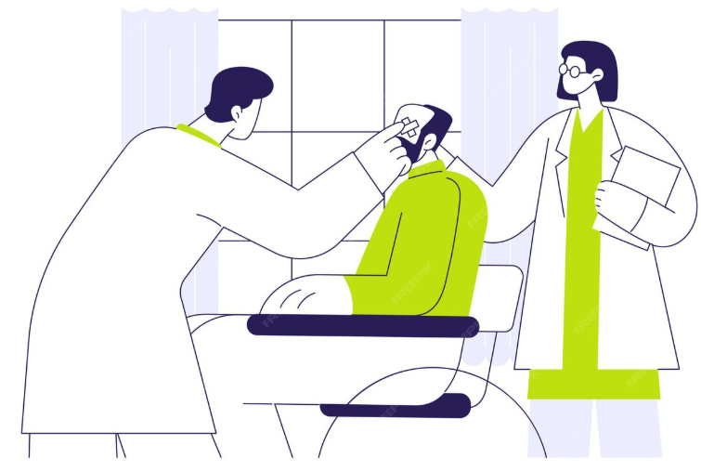
What is a Hospital ?
Patients
Doctors
Building

Slide 3
What is a Hospital ?
Building
Patients
Doctors

Slide 4
What is a Hospital ?
Patients
Doctors
Building

Slide 5



Missing Leads
Manual Data Records
Better Decisions

Slide 6
Hospital

Slide 7

Roles
Hospital
Doctors
Patients
Management

Slide 8
Roles
Hospital
Patients
Doctors
Management

Slide 9






Patients
Finance
Roles
Doctors
Patient-related Records
Tables
Management
Management

Slide 10
Finance
Patients
Patient-related Records
Tables
Roles
Doctors
Management
Management

Slide 11
Patients
Roles
Doctors
Finance
Tables
Management
Patient-related Records

Slide 12
Management
Patients
Roles
Patient Records
Tables
Doctors
Finance

Slide 13
Patient Records
Management
Details
Patients
Roles
Tables
Finance
Doctors

Slide 14
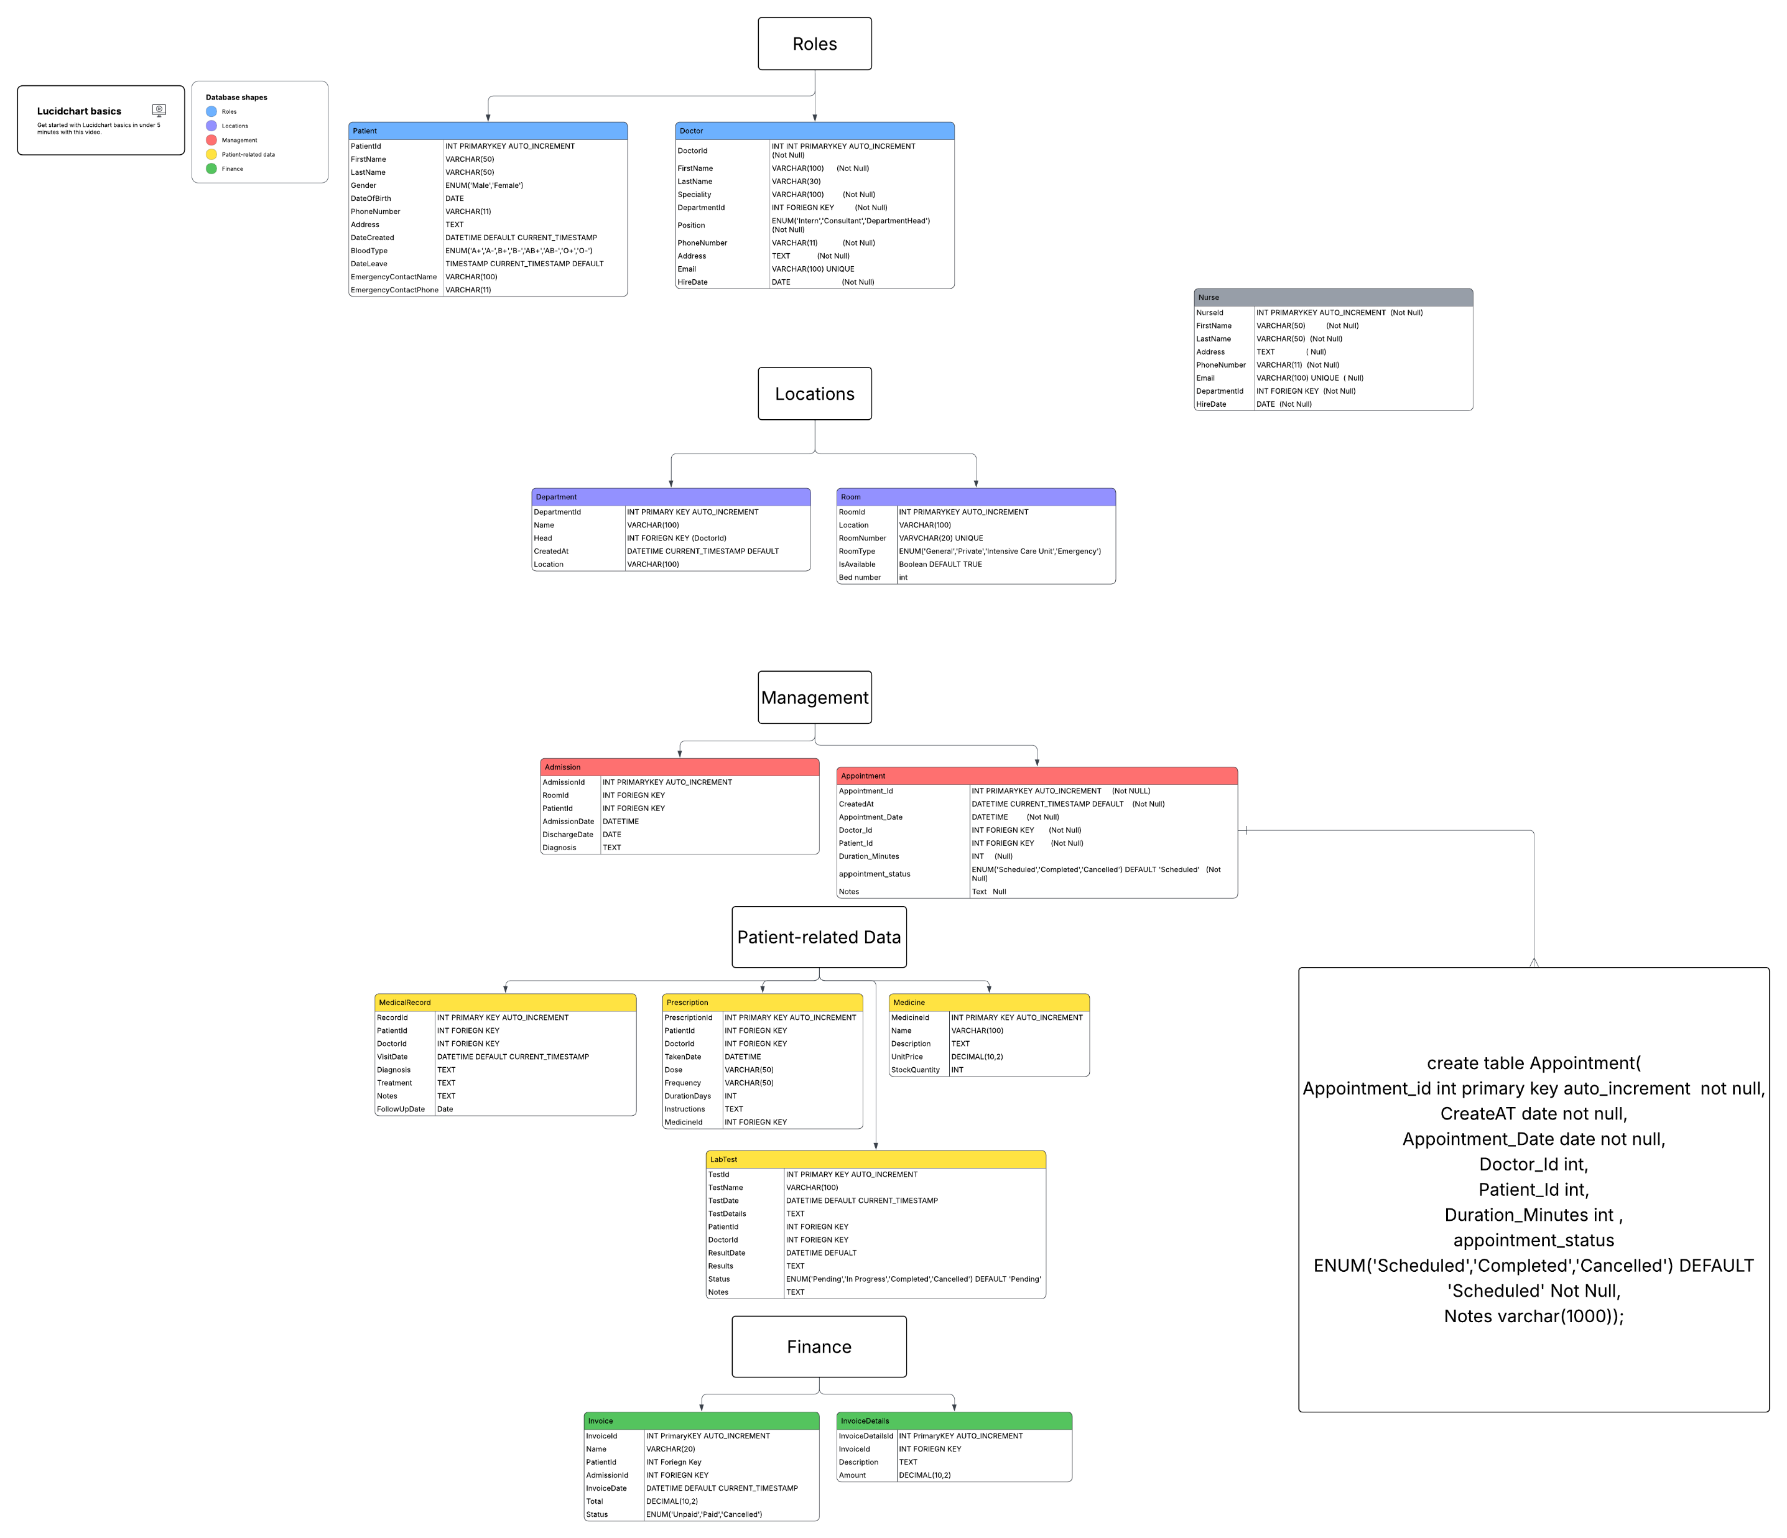

Slide 23






Elsayed Sharawy
Mohamed Hany
Altarek Attallah
Hussein Saleh
Ali Alsaed
Amr Gamal

